Slide 1
ConvNeXt Block 2022
RepNeXt Block Training-time
Our Block Inference-time
dim-chan
dim-chan
dim-chan
DwConv 7×7 dim
DwConv
3×3 dim/3
DwConv
5×5 dim/3
DwConv
7×7 dim/3
GConv 7×7
dim×2 Group=dim
LN
BN
Conv 1×1 4×dim
GELU
Conv 1×1 4×dim
Conv 1×1 5×dim
GELU
GELU
GELU
Conv 1×1 dim
Conv 1×1 dim
Conv 1×1 dim

Slide 2
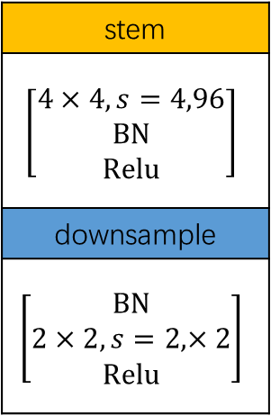
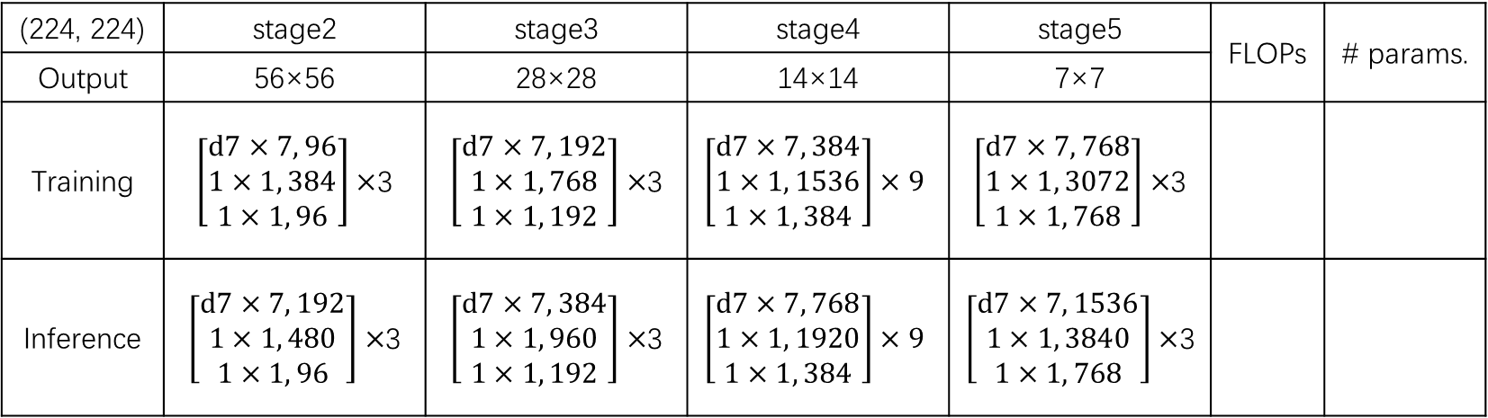
(224, 224) | stage2 | stage3 | stage4 | stage5 | FLOPs | # params.
Output | 56×56 | 28×28 | 14×14 | 7×7
Training | $\left[\begin{aligned}d7×7, 96 \\ 1×1, 384 \\ 1×1, 96\end{aligned}\right]×$3 | $\left[\begin{aligned}d7×7, 192 \\ 1×1, 768 \\ 1×1, 192\end{aligned}\right]×$3 | $$\left[\begin{aligned}d7×7, 384 \\ 1×1, 1536 \\ 1×1, 384\end{aligned}\right]×9$$ | $\left[\begin{aligned}d7×7, 768 \\ 1×1, 3072 \\ 1×1, 768\end{aligned}\right]×$3
Inference | $\left[\begin{aligned}d7×7, 192 \\ 1×1, 480 \\ 1×1, 96\end{aligned}\right]×$3 | $\left[\begin{aligned}d7×7, 384 \\ 1×1, 960 \\ 1×1, 192\end{aligned}\right]×$3 | $$\left[\begin{aligned}d7×7, 768 \\ 1×1, 1920 \\ 1×1, 384\end{aligned}\right]×9$$ | $\left[\begin{aligned}d7×7, 1536 \\ 1×1, 3840 \\ 1×1, 768\end{aligned}\right]×$3
stem
$$\left[\begin{aligned}4×4, s=4,96 \\ BN \\ Relu\end{aligned}\right]$$
downsample
$$\left[\begin{aligned}BN \\ 2×2, s=2,×2 \\ Relu\end{aligned}\right]$$

Slide 3
RepNeXt Block Training-time
RepNeXt Block Training-time
dim
dim
DwConv
3×3 dim/3
DwConv
5×5 dim/3
DwConv
7×7 dim/3
DwConv
3×3 dim BN
DwConv
5×5 dim BN
DwConv
7×7 dim BN
Concat
GELU
BN; Conv 1×1 4×dim; GELU
GELU
Conv 1×1 4×dim; GELU
Conv 1×1 dim
Conv 1×1 dim

Slide 4
dim
dim
DwConv
3×3 dim/3
DwConv
5×5 dim/3
DwConv
7×7 dim/3
DwConv
3×3 dim BN
DwConv
5×5 dim BN
DwConv
7×7 dim BN
Concat
×dim
DwConv
7×7 dim/3
DwConv
7×7 dim
fuse BN
Padding
×dim
DwConv
5×5 dim/3
DwConv
5×5 dim
fuse BN
Padding
Add
×dim
DwConv
3×3 dim/3
Padding
DwConv
3×3 dim
fuse BN
Concat
Padding

Slide 5
dim
DwConv
3×1 dim BN
DwConv
1×5 dim BN
DwConv
7×7 dim BN
×dim
DwConv
7×7 dim
fuse BN
×dim
DwConv
1×5 dim
fuse BN
Padding
Add
×dim
DwConv
3×1 dim
fuse BN
Padding

Slide 6
A
A
A

